Slide 1
ECE 3430 Introduction to Embedded Computer Systems
Brushed DC and Stepper Motor Control

Slide 2
Project Requirements
Use hardware-based PWM to run a Brushed DC motor at 60 RPM
Use motor driver to drive stepper motor at 60 RPM

Slide 3
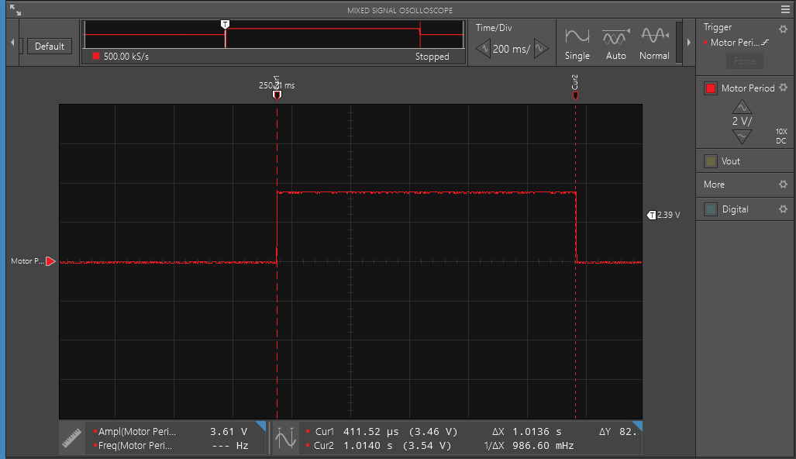
Results – 60 RPM, Brushed DC Example
The LED was toggled each rotation, so half a period marks a full rev.
Slightly over 1s
<number>

Slide 4
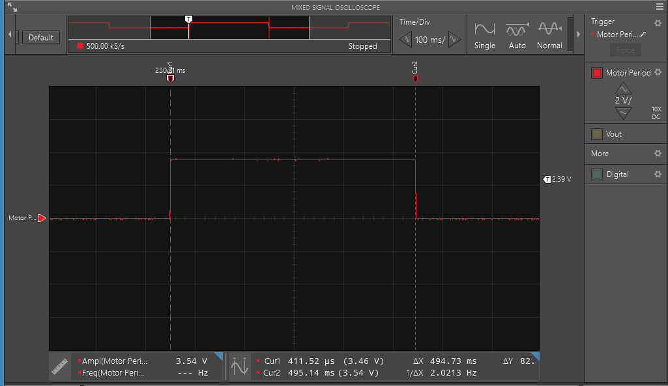
Results – 120 RPM, Brushed DC Example
<number>

Slide 5
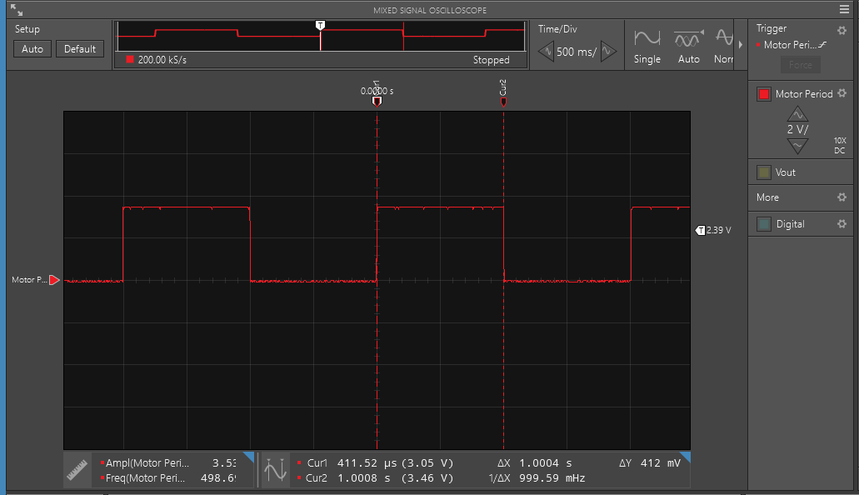
Results - 60RPM, Stepper Motor
Almost exactly 1s
<number>

Slide 6
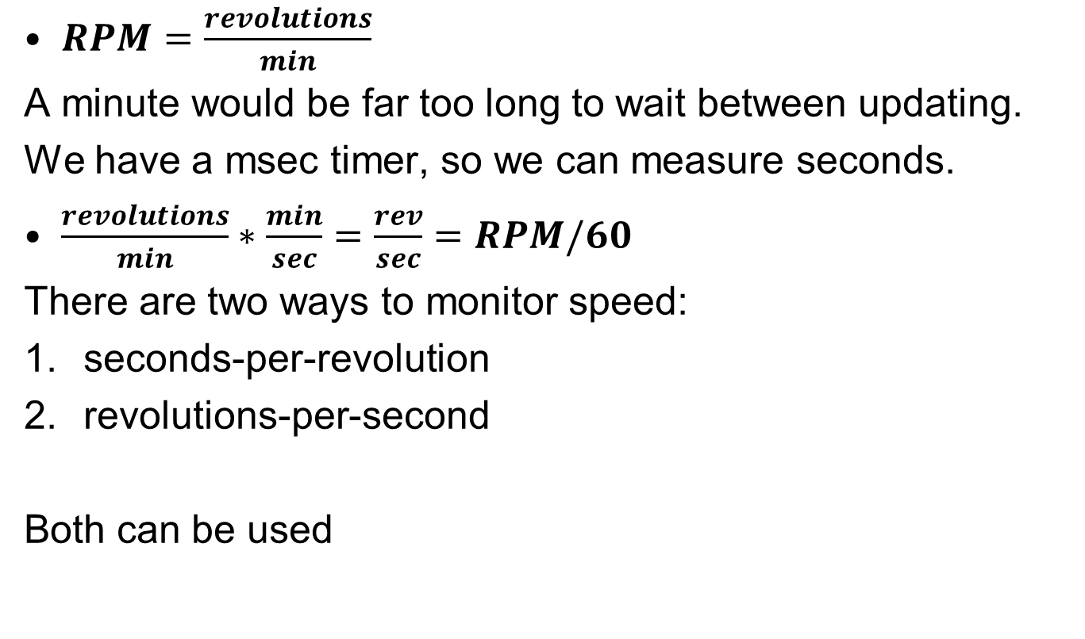
Calculating RPM
<number>
Notes:
Slide converted to image because of equations in textbox

Slide 7
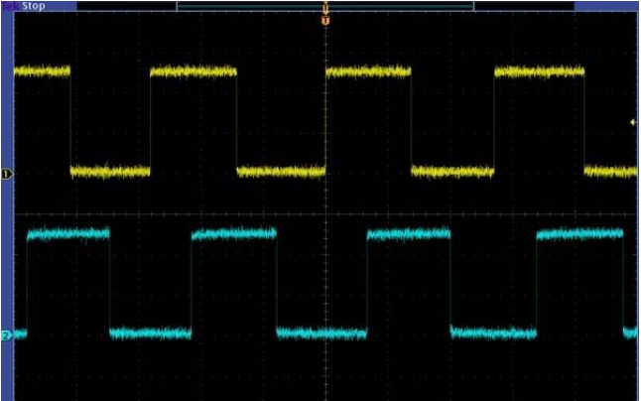
Measuring RPM
Output from Channel A (yellow) and B (white/blue). Encoder is designed such that 48 state changes (both channels, rising and falling edges) represents ONE revolution of the rotor. Gearbox is 9.68:1, so wheel rotates ~1/10th the rotor speed.
Source: Pololu 9.7:1 Metal Gearmotor datasheet.
<number>

Slide 8
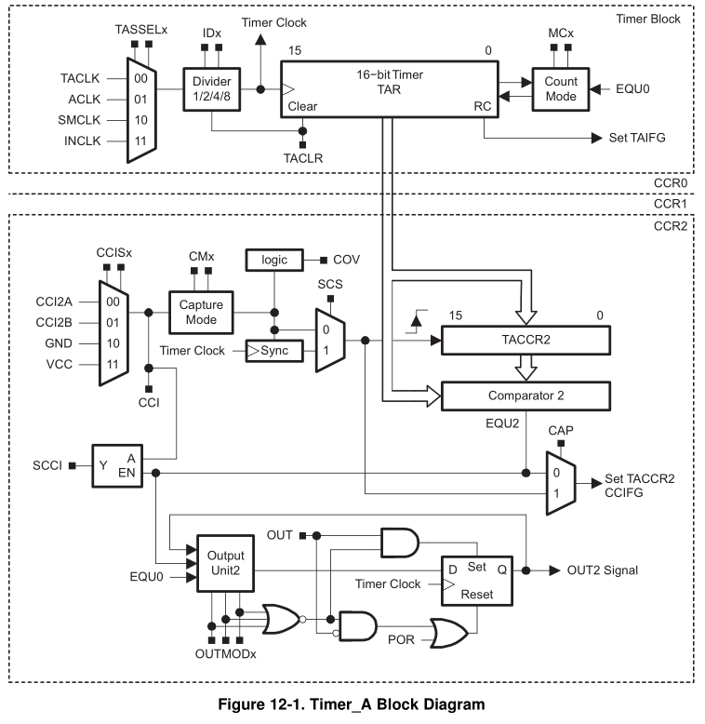
Hardware PWM
Each CCRx module has an OUTx signal, set and reset by comparators in hardware. One just needs to set the OUTMODE bits.
Source: Page 357 in User Guide
<number>

Slide 9
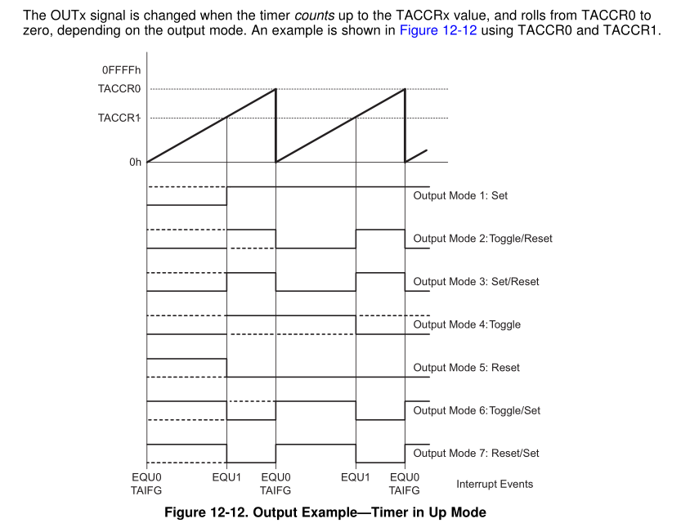
Hardware PWM
Source: Page 364 in User Guide
<number>

Slide 10
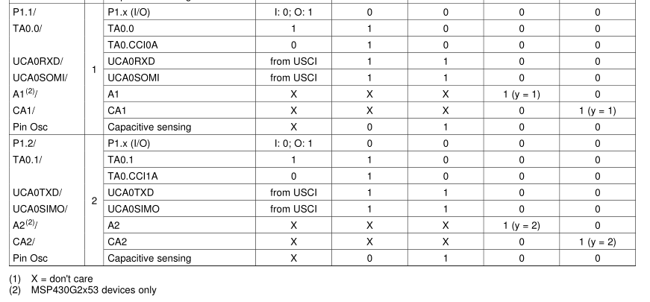
Hardware PWM – Assigning Pins
This means TimerA0,Output1
Source: Page 43 in Datasheet
<number>

Slide 11
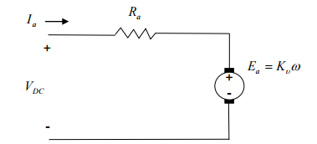

Intro to Brushed DC Motors
Winding Resistance
Winding Inductance
Back-EMF
L_{a}
Motor Speed
Motor Constant (geometry-dependent)
Image Source: US Naval Academy
<number>

Slide 12
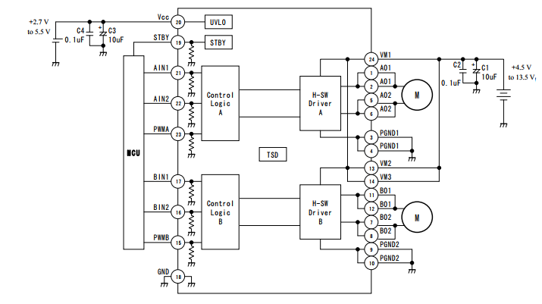
Motor Driver Block Diagram – Brushed DC
AIN bits control direction
PWM controls output voltage
Output B not used
<number>

Slide 13
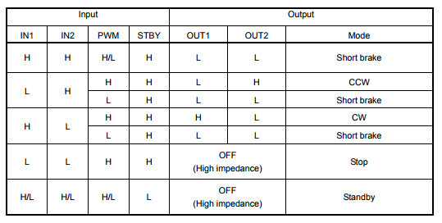
Motor Driver Modes
Source: TB66 Datasheet page 4
<number>

Slide 14
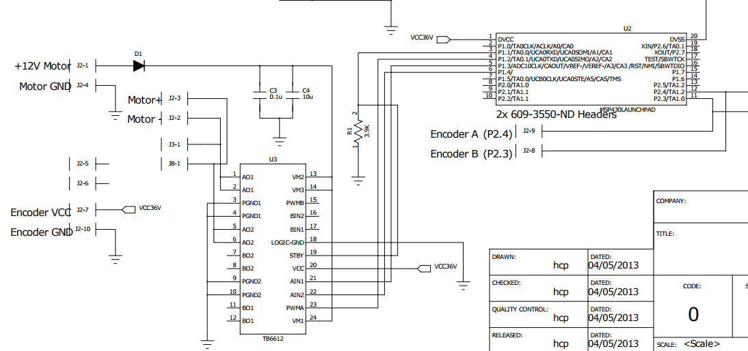
Motor Driver Header Board Schematic
MSP430
Encoder uses same ports as other headerboard
TB66
<number>

Slide 15
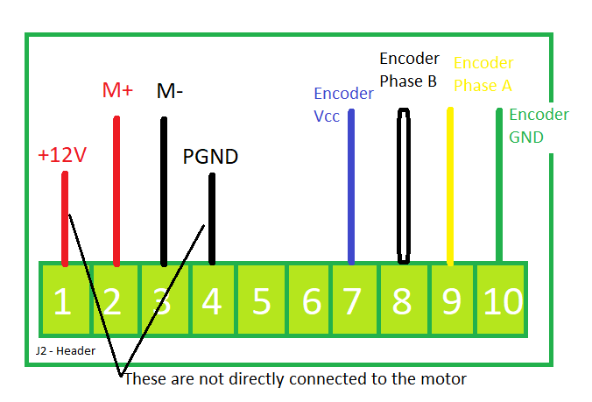
Motor Driver Header Board Connections
<number>

Slide 16
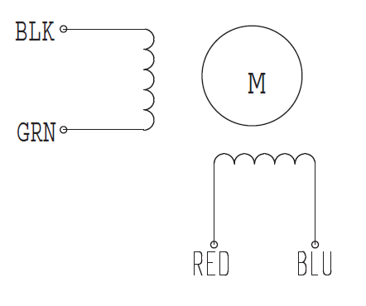
Intro to Stepper Motors
Extra Info Here
Wiring diagram of the SY28STH32-0674A hybrid bipolar stepper motor.
Motor coil, to connect to driver pins
Motor coil, to connect to driver pins
<number>

Slide 17
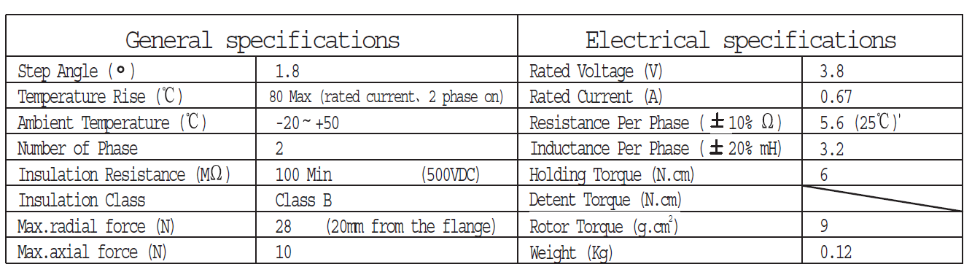
Intro to Stepper Motors
Step angle resolution
(SY28STH32 datasheet)
<number>

Slide 18
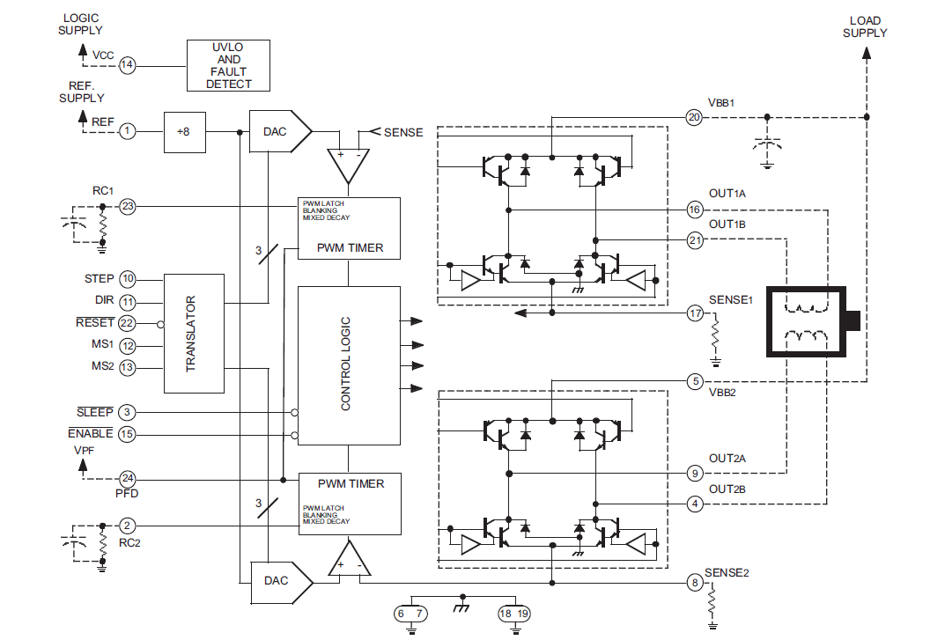
Motor Driver Block Diagram – Stepper
H bridge outputs to connect to coil
Stepper Motor
H bridge outputs to connect to coil
* Look at the headerboard PCB layout for the connector pinout
<number>

Slide 19
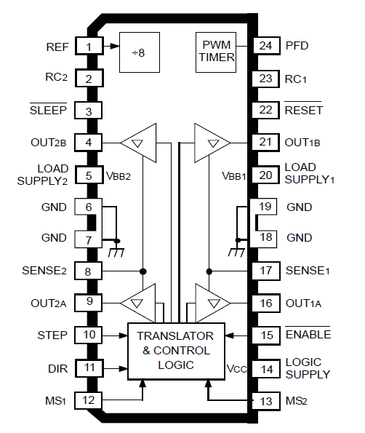
Controlling the Motor Driver
The motor can be driven in full, half, quarter, and eighth steps depending on the configuration of the translator.
Current at outputs is controlled by the translator. The translator is controlled by the microcontroller via STEP, DIR, MS1, MS2, and ENABLE pins.
<number>

